Slide 1
Layers of OSI Model
Ref: https://www.geeksforgeeks.org/tcp-ip-model/?ref=lbp
https://www.youtube.com/watch?v=vv4y_uOneC0&t=322s

Slide 2
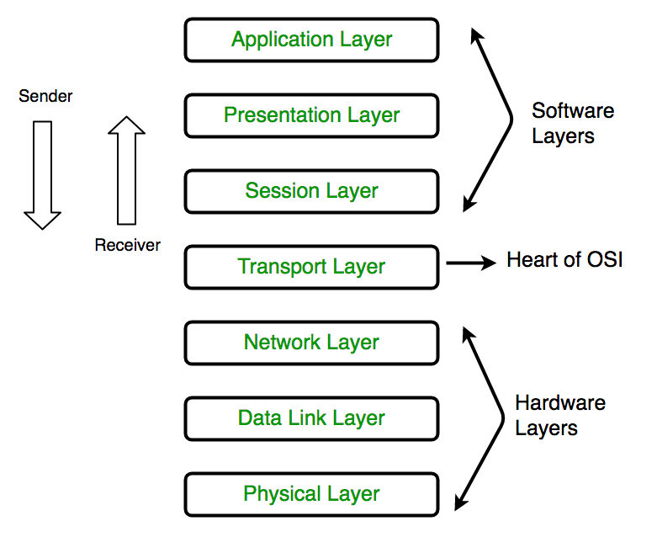
OSI stands for Open Systems Interconnection. It has been developed by ISO – ‘International Organization of Standardization‘, in the year 1984.
It is a 7 layer architecture with each layer having specific functionality to perform. All these 7 layers work collaboratively to transmit the data from one person to another across the globe.

Slide 3
7 Layers
All
People
Seem
To
Need
Data
Processing
7. Application Layer
Presentation Layer
Session Layer
Transport Layer
Network Layer
Data Link Layer
Physical Layer

Slide 4
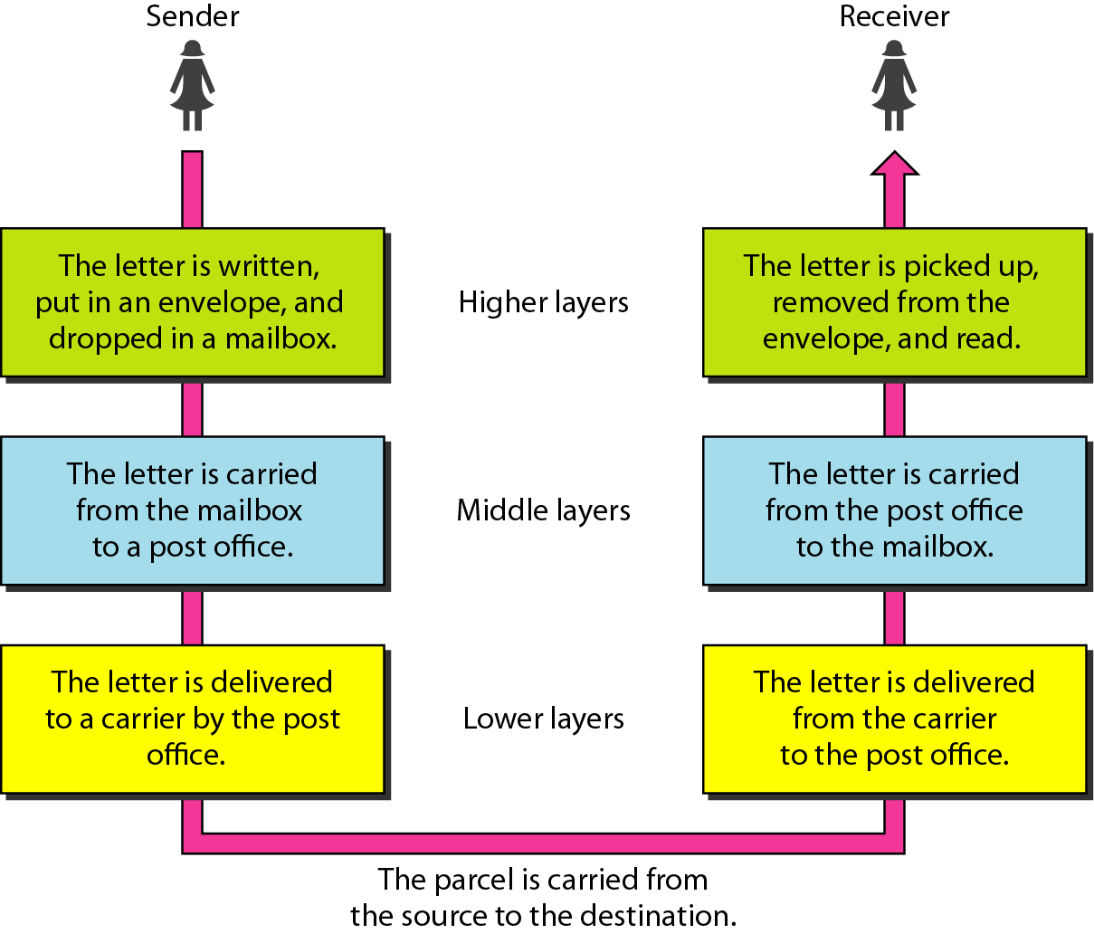
Tasks involved in sending letter

Slide 5
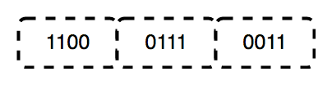
1. Physical Layer (Layer 1)
The lowest layer of the OSI
Responsible for the actual physical connection between the devices
The physical layer contains information in the form of bits
Responsible for transmitting individual bits from one node to the next
When receiving data, this layer will get the signal received and convert it into 0s and 1s and send them to the Data Link layer, which will put the frame back together.
Signal to bit
Bit to signal

Slide 6
The functions of the physical layer are
Bit synchronization: the synchronization of the bits happens by providing a clock. This clock controls both sender and receiver thus providing synchronization at bit level.
Bit rate control: The Physical layer also defines the transmission rate i.e. the number of bits sent per second.
Physical topologies: Physical layer specifies the way in which the different, devices/nodes are arranged in a network i.e. bus, star or mesh topology.
Transmission mode: defines the way in which the data flows between the two connected devices. The various transmission modes possible are: Simplex, half-duplex and full-duplex.
* Hub, Repeater, Modem, Cables are Physical Layer devices. ** Network Layer, Data Link Layer and Physical Layer are also known as Lower Layers or Hardware Layers.

Slide 7
2. Data Link Layer (DLL) (Layer 2) :
The data link layer is responsible for the node to node delivery of the message.
The main function of this layer is to make sure data transfer is error-free from one node to another, over the physical layer.
When a packet arrives in a network, it is the responsibility of DLL to transmit it to the Host using its MAC address(48 bits). Data Link Layer is divided into two sub layers :
Logical Link Control (LLC)
Media Access Control (MAC)

Slide 8
The packet received from Network layer is further divided into frames depending on the frame size of NIC(Network Interface Card). DLL also encapsulates Sender and Receiver’s MAC address in the header.
The Receiver’s MAC address is obtained by placing an ARP(Address Resolution Protocol) request onto the wire asking “Who has that IP address?” and the destination host will reply with its MAC address.

Slide 9
The functions of the data Link layer are :
Framing: Framing is a function of the data link layer. It provides a way for a sender to transmit a set of bits that are meaningful to the receiver. This can be accomplished by attaching special bit patterns to the beginning and end of the frame.
Physical addressing: After creating frames, Data link layer adds physical addresses (MAC address) of sender and/or receiver in the header of each frame.
Error control: Data link layer provides the mechanism of error control in which it detects and retransmits damaged or lost frames.
Flow Control: The data rate must be constant on both sides else the data may get corrupted thus , flow control coordinates that amount of data that can be sent before receiving acknowledgement.
Access control: When a single communication channel is shared by multiple devices, MAC sub-layer of data link layer helps to determine which device has control over the channel at a given time.
* Packet in Data Link layer is referred as Frame. ** Data Link layer is handled by the NIC (Network Interface Card) and device drivers of host machines. *** Switch & Bridge are Data Link Layer devices.

Slide 10
Adnan.cse@uap-bd.edu rasel@uap-bd.edu =10101010101010=32 bit
Main message
Hi Rasel Babu, how are you?my bank details is…. Pls take 2 crore taka .
Login rasel
Password 12345
= 1001000001111000001111100000110100001110000000000000000010101010100101010100101010101010101010101= 200 bit
Encryption /decryption
Compression/decompression
IP address 32bit sender
32 bit reciever
MAC address= 48 bit
Framing 32+200+32+32+48
Sending bits and convert to signal

Slide 11
Network Layer (Layer 3)
Network layer works for the transmission of data from one host to the other located in different networks. It also takes care of packet routing i.e. selection of the shortest path to transmit the packet, from the number of routes available. The sender & receiver’s IP address are placed in the header by the network layer. The functions of the Network layer are :
Routing: The network layer protocols determine which route is suitable from source to destination. This function of network layer is known as routing.
Logical Addressing: In order to identify each device on internetwork uniquely, network layer defines an addressing scheme. The sender & receiver’s IP address are placed in the header by network layer. Such an address distinguishes each device uniquely and universally.
* Segment in Network layer is referred as Packet.
Network layer is implemented by networking devices such as routers.

Slide 12
Transport Layer (Layer 4)
Transport layer provides services to application layer and takes services from network layer. The data in the transport layer is referred to as Segments. It is responsible for the End to End Delivery of the complete message. The transport layer also provides the acknowledgement of the successful data transmission and re-transmits the data if an error is found.

Slide 13
• At sender’s side: Transport layer receives the formatted data from the upper layers, performs Segmentation and also implements Flow & Error control to ensure proper data transmission. It also adds Source and Destination port number in its header and forwards the segmented data to the Network Layer. Note: The sender need to know the port number associated with the receiver’s application. Generally, this destination port number is configured, either by default or manually. For example, when a web application makes a request to a web server, it typically uses port number 80, because this is the default port assigned to web applications. Many applications have default port assigned. • At receiver’s side: Transport Layer reads the port number from its header and forwards the Data which it has received to the respective application. It also performs sequencing and reassembling of the segmented data.

Slide 14
The functions of the transport layer are :
Segmentation and Reassembly: This layer accepts the message from the (session) layer , breaks the message into smaller units . Each of the segment produced has a header associated with it. The transport layer at the destination station reassembles the message.
Service Point Addressing: In order to deliver the message to correct process, transport layer header includes a type of address called service point address or port address. Thus by specifying this address, transport layer makes sure that the message is delivered to the correct process.

Slide 15
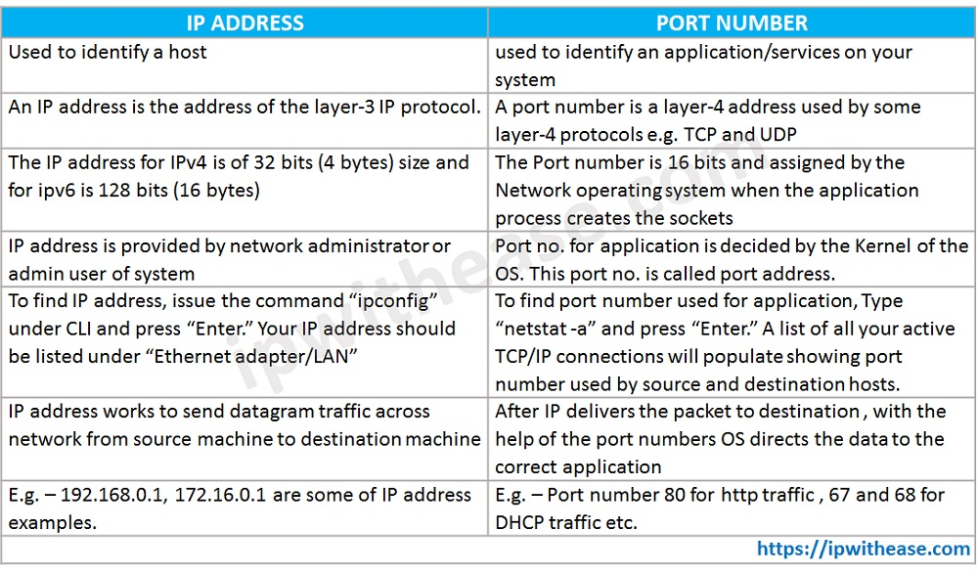
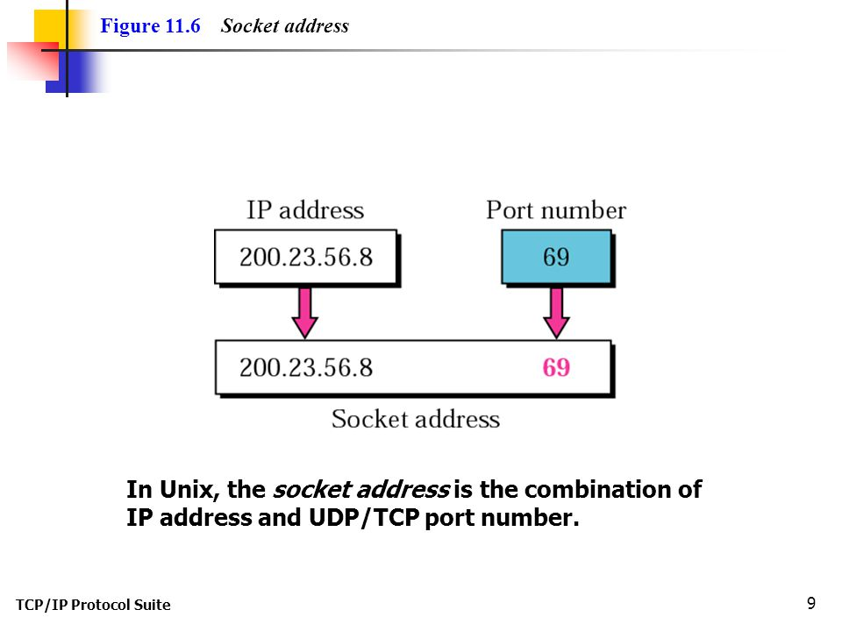
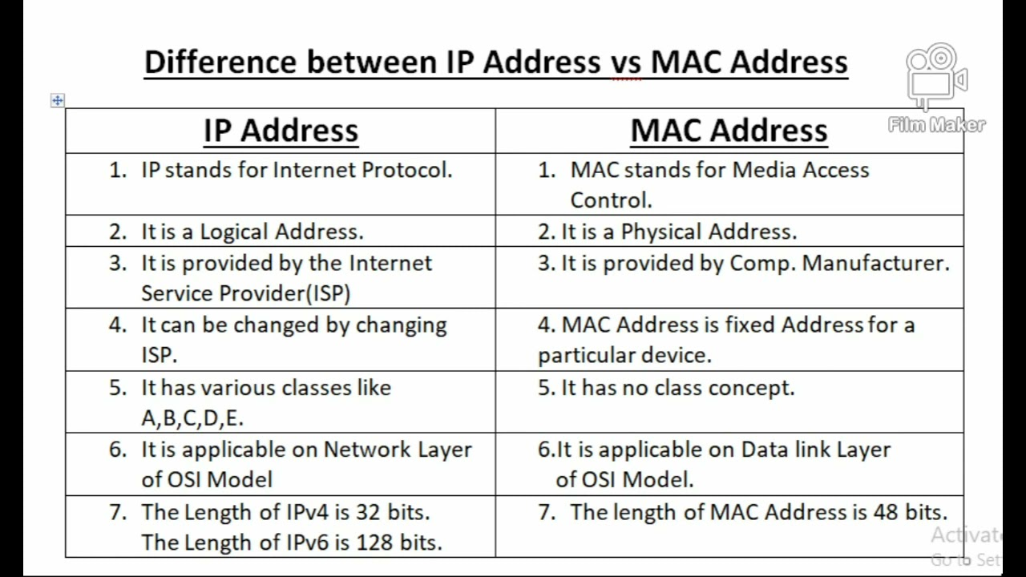

Slide 16
There are 65,535 possible port numbers, although not all are in common use. Some of the most commonly used ports:
Ports 20 and 21: File Transfer Protocol (FTP). FTP is for transferring files between a client and a server.
Port 22: Secure Shell (SSH). SSH is one of many tunneling protocols that create secure network connections.
Port 25: Simple Mail Transfer Protocol (SMTP). SMTP is used for email.
Port 53: Domain Name System (DNS). DNS is an essential process for the modern Internet; it matches human-readable domain names to machine-readable IP addresses, enabling users to load websites and applications without memorizing a long list of IP addresses.
Port 80: Hypertext Transfer Protocol (HTTP). HTTP is the protocol that makes the World Wide Web possible.
Port 123: Network Time Protocol (NTP). NTP allows computer clocks to sync with each other, a process that is essential for encryption.
Port 179: Border Gateway Protocol (BGP). BGP is essential for establishing efficient routes between the large networks that make up the Internet (these large networks are called autonomous systems). Autonomous systems use BGP to broadcast which IP addresses they control.
Port 443: HTTP Secure (HTTPS). HTTPS is the secure and encrypted version of HTTP. All HTTPS web traffic goes to port 443. Network services that use HTTPS for encryption, such as DNS over HTTPS, also connect at this port.
Port 500: Internet Security Association and Key Management Protocol (ISAKMP), which is part of the process of setting up secure IPsec connections.
Port 3389: Remote Desktop Protocol (RDP). RDP enables users to remotely connect to their desktop computers from another device.
The Internet Assigned Numbers Authority (IANA) maintains the full list of port numbers and protocols assigned to them.

Slide 17
The services provided by the transport layer
Connection Oriented Service: It is a three-phase process which include – Connection Establishment – Data Transfer – Termination / disconnection In this type of transmission, the receiving device sends an acknowledgement, back to the source after a packet or group of packet is received. This type of transmission is reliable and secure.
Connection less service: It is a one-phase process and includes Data Transfer. In this type of transmission, the receiver does not acknowledge receipt of a packet. This approach allows for much faster communication between devices. Connection-oriented service is more reliable than connectionless Service.
* Data in the Transport Layer is called as Segments. ** Transport layer is operated by the Operating System. It is a part of the OS and communicates with the Application Layer by making system calls. Transport Layer is called as Heart of OSI model.

Slide 18
**All the below 3 layers are integrated as a single layer in the TCP/IP model as “Application Layer”. **Implementation of these 3 layers is done by the network application itself. These are also known as Upper Layers or Software Layers.

Slide 19
Session Layer (Layer 5) :
This layer is responsible for establishment of connection, maintenance of sessions, authentication and also ensures security. The functions of the session layer are :
Session establishment, maintenance and termination: The layer allows the two processes to establish, use and terminate a connection.
Synchronization : This layer allows a process to add checkpoints which are considered as synchronization points into the data. These synchronization point help to identify the error so that the data is re-synchronized properly, and ends of the messages are not cut prematurely and data loss is avoided.
Dialog Controller : The session layer allows two systems to start communication with each other in half-duplex or full-duplex.

Slide 20
Presentation Layer (Layer 6) :
Presentation layer is also called the Translation layer. The data from the application layer is extracted here and manipulated as per the required format to transmit over the network.
The functions of the presentation layer are :
Translation : For example, ASCII to EBCDIC. (HOME WORK***)
Encryption/ Decryption : Data encryption translates the data into another form or code. The encrypted data is known as the cipher text and the decrypted data is known as plain text. A key value is used for encrypting as well as decrypting data.
Compression: Reduces the number of bits that need to be transmitted on the network.
***https://askanydifference.com/difference-between-ascii-and-ebcdic/

Slide 21
Application Layer (Layer 7) :
At the very top of the OSI Reference Model stack of layers, we find Application layer which is implemented by the network applications.
These applications produce the data, which has to be transferred over the network.
This layer also serves as a window for the application services to access the network and for displaying the received information to the user. Ex: Application – Browsers, Skype Messenger etc. **Application Layer is also called as Desktop Layer.

Slide 22
The functions of the Application layer are : Home work
Network Virtual Terminal
FTAM-File transfer access and management
Mail Services
Directory Services
OSI model acts as a reference model and is not implemented in the Internet because of its late invention. Current model being used is the TCP/IP model.

Slide 23
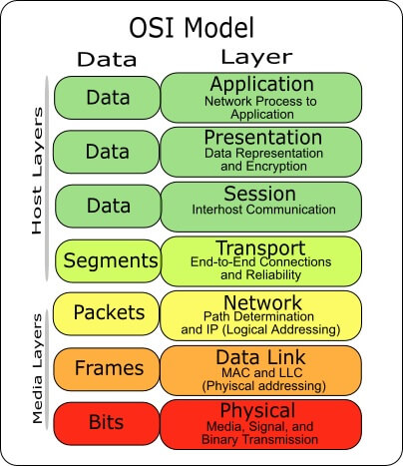
NAMING of DATA in several stages of OSI model

Slide 24
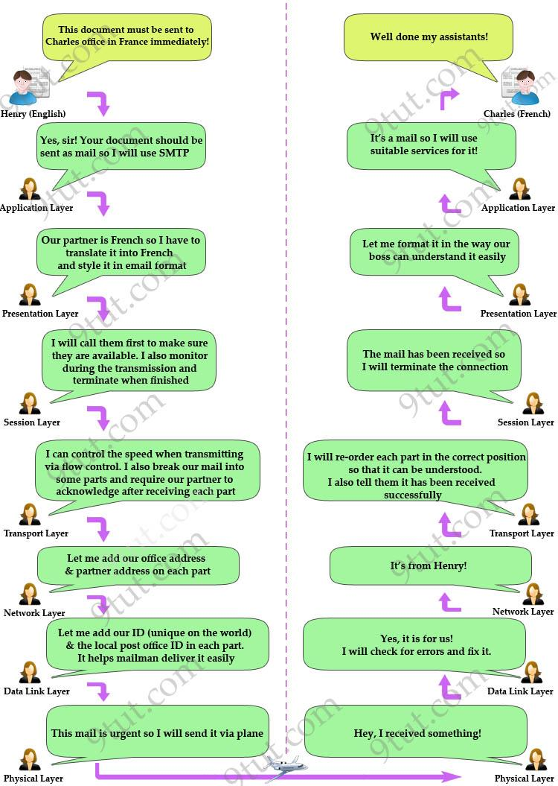

Slide 25
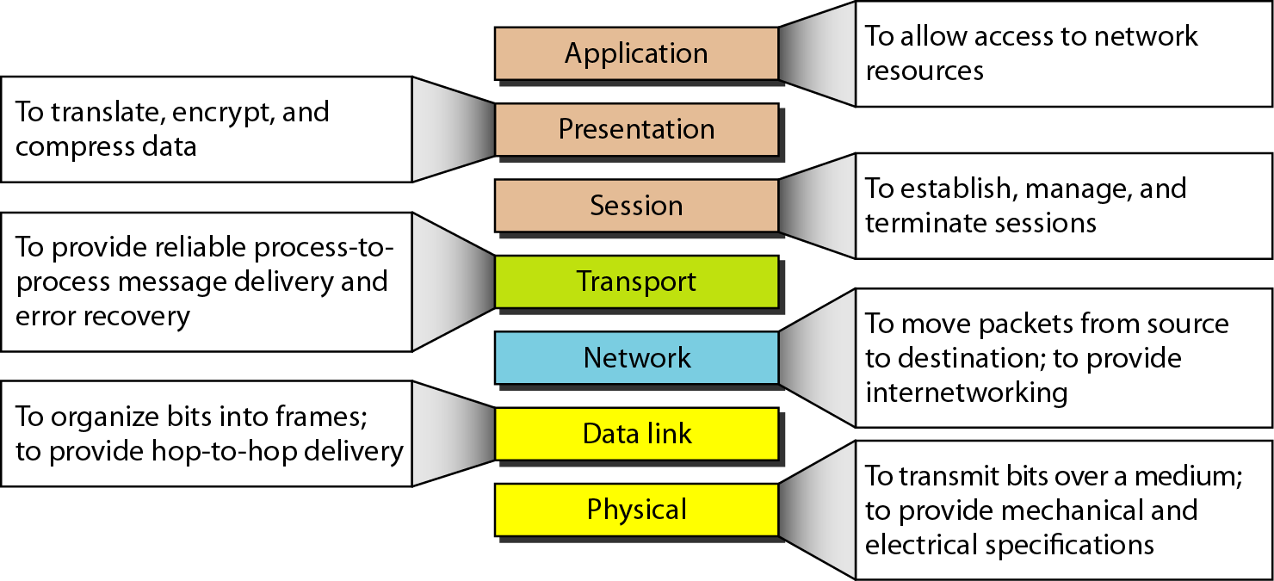
At a glance

Slide 27
From OSI to TCP/IP

Slide 28
The OSI Model we just looked at is just a reference/logical model. It was designed to describe the functions of the communication system by dividing the communication procedure into smaller and simpler components.
But when we talk about the TCP/IP model, it was designed and developed by Department of Defense (DoD) in 1960s and is based on standard protocols. It stands for Transmission Control Protocol/Internet Protocol.
The TCP/IP model is a concise version of the OSI model. It contains four layers, unlike seven layers in the OSI model. The layers are:
Process/Application Layer
Host-to-Host/Transport Layer
Internet Layer
Network Access/Link Layer

Slide 29
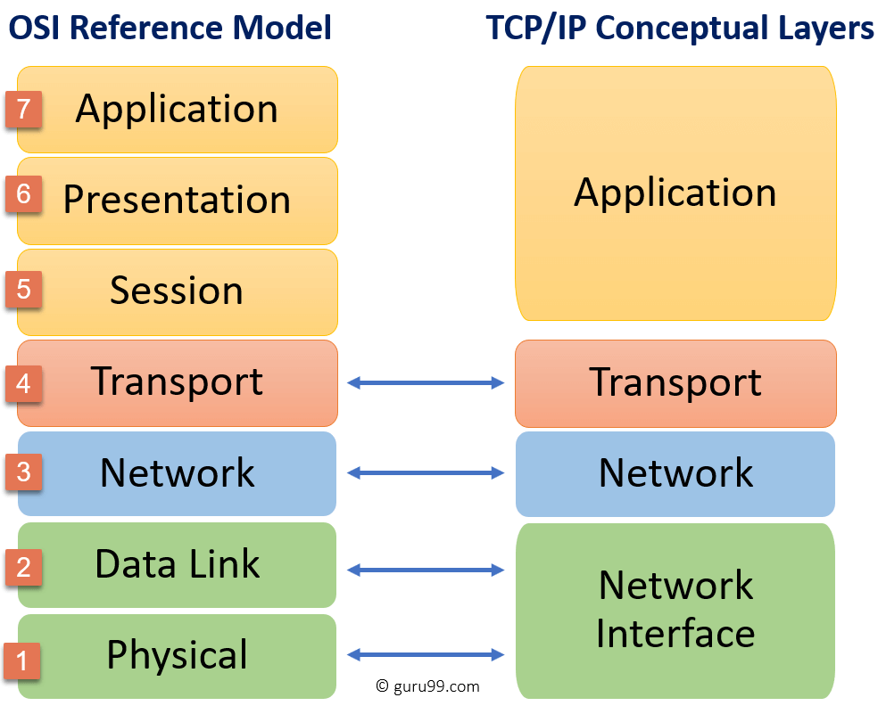

Slide 30
Difference between TCP/IP and OSI Model:
TCP/IP | OSI
TCP refers to Transmission Control Protocol. | OSI refers to Open Systems Interconnection.
TCP/IP has 4 layers. | OSI has 7 layers.
TCP/IP is more reliable | OSI is less reliable
TCP/IP does not have very strict boundaries. | OSI has strict boundaries
TCP/IP follow a horizontal approach. | OSI follows a vertical approach.
TCP/IP uses both session and presentation layer in the application layer itself. | OSI uses different session and presentation layers.
TCP/IP developed protocols then model. | OSI developed model then protocol.
Transport layer in TCP/IP does not provide assurance delivery of packets. | In OSI model, transport layer provides assurance delivery of packets.
TCP/IP model network layer only provides connection less services. | Connection less and connection oriented both services are provided by network layer in OSI model.
Protocols cannot be replaced easily in TCP/IP model. | While in OSI model, Protocols are better covered and is easy to replace with the change in technology.

Slide 31
The first layer is the Process layer on the behalf of the sender and Network Access layer on the behalf of the receiver. During this article, we will be talking on the behalf of the receiver.
1. Network Access Layer –
This layer corresponds to the combination of Data Link Layer and Physical Layer of the OSI model. It looks out for hardware addressing and the protocols present in this layer allows for the physical transmission of data. We just talked about ARP being a protocol of Internet layer, but there is a conflict about declaring it as a protocol of Internet Layer or Network access layer. It is described as residing in layer 3, being encapsulated by layer 2 protocols.

Slide 32
2. Internet Layer –
This layer parallels the functions of OSI’s Network layer. It defines the protocols which are responsible for logical transmission of data over the entire network. The main protocols residing at this layer are :
IP – stands for Internet Protocol and it is responsible for delivering packets from the source host to the destination host by looking at the IP addresses in the packet headers. IP has 2 versions: IPv4 and IPv6. IPv4 is the one that most of the websites are using currently. But IPv6 is growing as the number of IPv4 addresses are limited in number when compared to the number of users.
ICMP – stands for Internet Control Message Protocol. It is encapsulated within IP datagrams and is responsible for providing hosts with information about network problems.
ARP – stands for Address Resolution Protocol. Its job is to find the hardware address of a host from a known IP address. ARP has several types: Reverse ARP, Proxy ARP, Gratuitous ARP and Inverse ARP.

Slide 33
3. Host-to-Host Layer –
This layer is analogous to the transport layer of the OSI model. It is responsible for end-to-end communication and error-free delivery of data. It shields the upper-layer applications from the complexities of data. The two main protocols present in this layer are :
Transmission Control Protocol (TCP) – It is known to provide reliable and error-free communication between end systems. It performs sequencing and segmentation of data. It also has acknowledgment feature and controls the flow of the data through flow control mechanism. It is a very effective protocol but has a lot of overhead due to such features. Increased overhead leads to increased cost.
User Datagram Protocol (UDP) – On the other hand does not provide any such features. It is the go-to protocol if your application does not require reliable transport as it is very cost-effective. Unlike TCP, which is connection-oriented protocol, UDP is connectionless.

Slide 34
4. Application Layer –
This layer performs the functions of top three layers of the OSI model: Application, Presentation and Session Layer. It is responsible for node-to-node communication and controls user-interface specifications. Some of the protocols present in this layer are: HTTP, HTTPS, FTP, TFTP, Telnet, SSH, SMTP, SNMP, NTP, DNS, DHCP, NFS, X Window, LPD.
HTTP and HTTPS – HTTP stands for Hypertext transfer protocol. It is used by the World Wide Web to manage communications between web browsers and servers. HTTPS stands for HTTP-Secure. It is a combination of HTTP with SSL(Secure Socket Layer). It is efficient in cases where the browser need to fill out forms, sign in, authenticate and carry out bank transactions.
SSH – SSH stands for Secure Shell. It is a terminal emulations software similar to Telnet. The reason SSH is more preferred is because of its ability to maintain the encrypted connection. It sets up a secure session over a TCP/IP connection.
NTP – NTP stands for Network Time Protocol. It is used to synchronize the clocks on our computer to one standard time source. It is very useful in situations like bank transactions. Assume the following situation without the presence of NTP. Suppose you carry out a transaction, where your computer reads the time at 2:30 PM while the server records it at 2:28 PM. The server can crash very badly if it’s out of sync.

Slide 35
